Slide 1
CAMEO Data Warehouse Testing
Release 1 - 8/2/2023

Slide 2
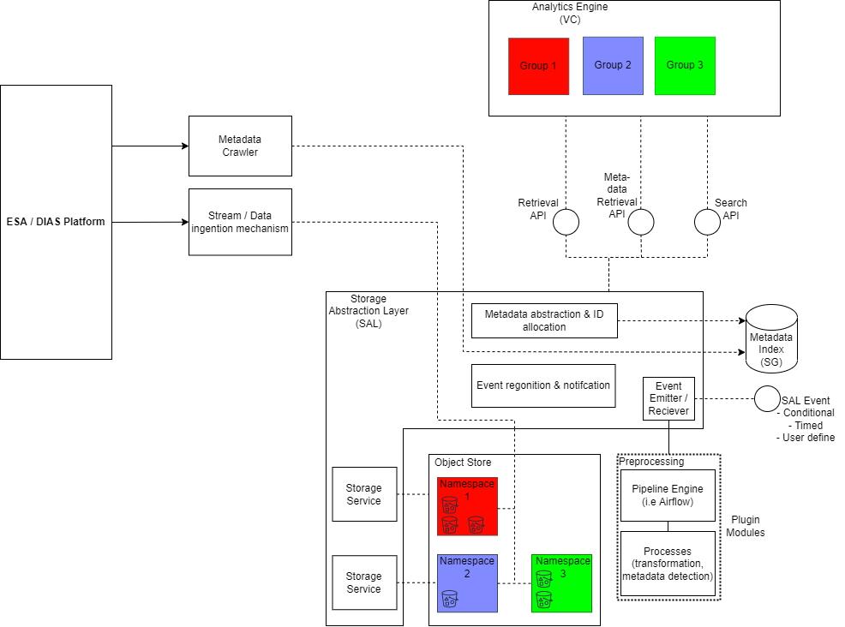
DW Release 1

Slide 3
Purpose of the testing
1. Get to know the platform
2. Provide input for the next development iteration
Have you had experience with any similar systems?
Do the query parameters currently provided satisfy your data access need?
Do the query responses contain all information you normally need?
Do you have comment on the 3 types of queries provided by the DW?
Anything else in the DW that meet/fail your expectations?
Have you encountered any bugs/unexpected behaviours?
(Bring your own questions/comments)
3. Not yet for performance testing

Slide 4
Setup - Windows
1. OpenVPN version 2.5.2 - connect to Dell's VPN
2. Cyberduck latest version - GUI application to access AWS S3 stores
3. Postman Agent latest version - GUI app to send HTTP requests to test the API

Slide 5
Setup - Windows - OpenVPN
Click here for video instruction
You need: OVPN conf file on the share drive, username and password emailed to you
Install OVPN software
Import the OVPN configuration file
Connect and provide username and password
Once complete with yout testing, disconnect from Dell's VPN
Note: After connecting to the VPN, your access to the internet will go through Dell's server
Note: There is an issue with connecting to Dell's VPN through UCD Wireless and Eduroam

Slide 6
Setup - Windows - Cyberduck
Click here for video instruction
Install Cyberduck
Set protocol as HTTP (not HTTPS)
Set storage class as Reduced Redundancy Storage
Server IP: 10.11.2.101
Port: 30878
Access Key ID: will be provided
Secret Access Key: any string (won't be checked)
With this done, you should be able to access the buckets in the object store
Notes:
different ip and port number for upload

Slide 7
Setup - Windows - Postman Agent
Click here for video instruction
End points:
10.11.1.6:8000/cameo/search
10.11.1.6:8000/cameo/metadata
10.11.1.6:8000/cameo/data
No other configuration needed (Namita to check?)
With this done, you should be able to send API requests

Slide 8
Test the object store
UCD can read from bucket: repository
UCD can read, write, create, update, delete, etc, on bucket: ucd
UCD should not be able to see the contents of, or do anything else with other partner buckets
Please inform me if you have some unintended privileges

Slide 9
Test the APIs
Rerun the queries provided in the API Documentation
Generate some queries by yourself
Document your experience, compare the API with other you have used before

Slide 10
Material
Share drive with configuration files, API documentation, dataset list, example commands, feedback sheet
VPN credentials and AWS Access ID will be sent by email

Slide 11
To-do
Consider adding new questions to the feedback sheet
Set up your machine for the testing
Test the object store and API. Try to explore around with different parameters, queries, etc. Note: Before you start and after you complete your testing, please drop a message to the Google group chat to let people know you are on the system
Provide your feedback in the feedback sheet

